Slide 1


DEPARTMENT OF ELECTRONICS AND COMMUNICATION ENGINEERING
A low Power energy efficient Design of reversible logic Gates
Team Members
Subha Harini.P (927622BEC208)
Swathi. D (927622BEC225)
Vennila.V (927622BEC247)
Vishnu Bharathi.J (927622BEC250)
Guided by
Ms.S.Kavitha
Notes:
Guided by
Ms.S.Kavitha

Slide 2
INTRODUCTION
Reversible logic gates are fundamental components in reversible computing, a paradigm where computations are performed such that both the inputs and outputs can be uniquely determined.
Unlike classical logic gates, reversible gates ensure that no information is lost during computation, meaning it's possible to reconstruct the inputs from the outputs.
The reversible logic gate is ,if we give input to the gate the output will be retrived and also the respective input can be retrived back from the output.

Slide 3
PROBLEM STATEMENT
Increased Complexity: Reversible logic gates often require more complex circuit.
Gate Count: Reversible logic gates typically require more gates to implement.
Propagation Delay: The additional logic required for reversibility can lead to increased propagation delays within the circuit.
Synthesis and Optimization Challenges: Synthesizing reversible logic circuits from Verilog code can be more challenging.
Power consumption : If the count of gate increases the power consumption also increases.

Slide 4
OBJECTIVES
Information Preservation
Energy Efficiency
Gate-level Optimization
Compatibility with Quantum Computing
Standardization and Integration
Verification and Testing
Education and Research

Slide 5
EXISTING SYSTEMS
Utilization of reversible logic gates in quantum computing to reduce power consumption.
Implementation of high-speed architectures for finding maximum/minimum values, emphasizing reduced power dissipation and efficient data transfer.
Another method involves investigating and implementing garbage-free reversible CPU computing systems, focusing on designing reversible arithmetic operations as essential components, and utilizing Xilinx software for design and simulation purposes

Slide 6
PROPOSED SYSTEM
The proposed concept entails the development of a Reversible Arithmetic and Logical Unit (ALU), representing a paradigm shift in computing architecture.
Gate-level implementation involves meticulous configuration of reversible gates tailored to specific arithmetic functions, such as addition, subtraction, and multiplication.
Extensive simulation and validation using industry-standard software, notably LTspice, verify the efficacy and performance of these designs.
Key advantages include minimal generation of 'garbage' outputs, signifying a notable reduction in resource wastage.

Slide 7
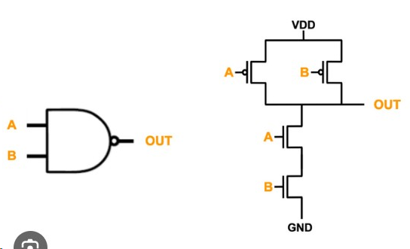
In our proposed system we have used Transistor and circuit level implementation.
Some basic reversible logic gates used :
NOT
Toffoli Gate
Peres Gate
CNOT Gate
FinFET is being applied.

Slide 8
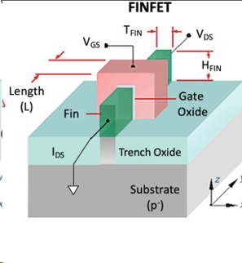
FinFET (Fin Field-effect Transistor) is used to contribute energy-efficient , high-performance computing system , particularly in emerging fields such as quantum computing and reversible computing.
Improved Switching Speed.
Better Scaling and integration.
Design Flexibility.
It is used to minimize power
Consumption.

Slide 9
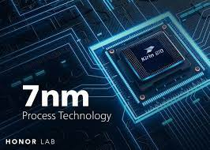
The implementation of GDI (Gate Diffusion Input) Logic , the main usage of GDI is to reduce the gate size .
For the implementation of AND Gate it requires 6 Gate for the circuit, if we implement it using GDI Logic we can reduce it as 2.
It has been implemented using the software called LTspice simulation

Slide 10
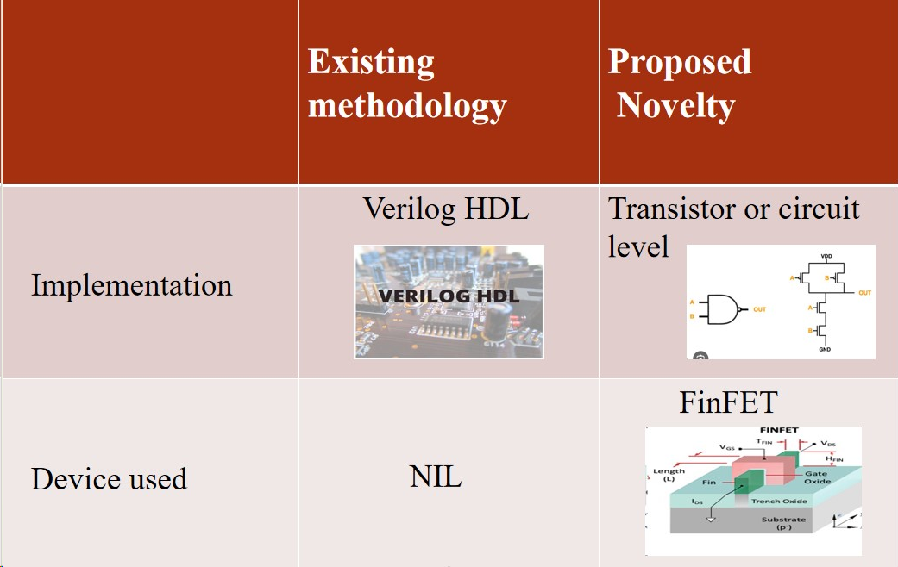
COMPARISON

Slide 11
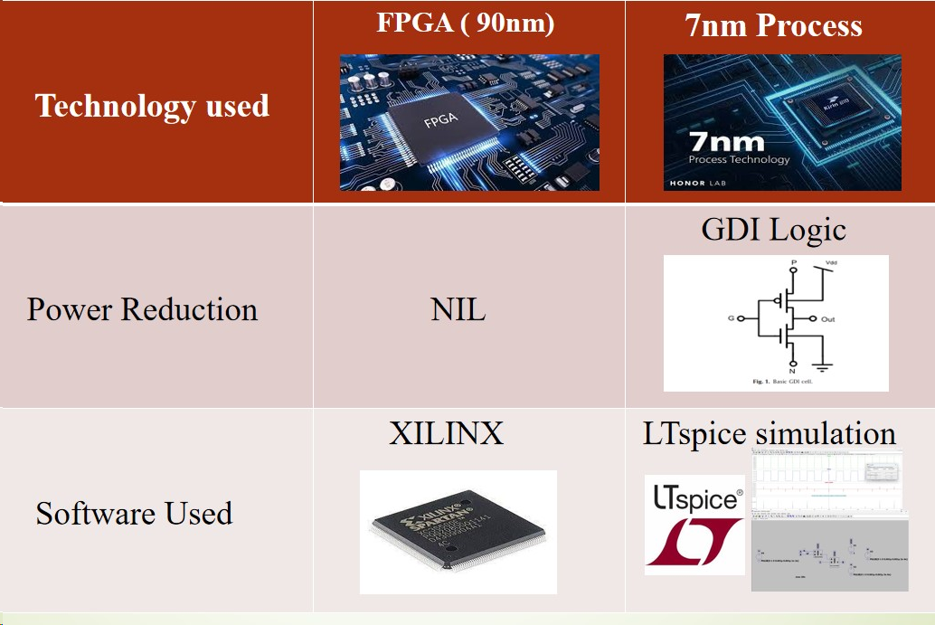

Slide 12
PLAN OF WORK COMPLETION
We have completed simulating the reversible logic gates like Toffoli Gate and NOT Gate using LTspice software.
That is, the GDI (Gate Diffusion Input) Logic inorder to reduce the number of gates is executed , thus power efficiency got improved.
Further, all the other reversible gates like Peres and CNOT Gates will be simulated in the LTspice software.

Slide 13
CONCLUSION
Thus, it is concluded that the high consumption of power in digital circuits can be reduced with the help of Gate Diffusion Input(GDI) Logic.
Overcame the drawbacks like bit loss in digital circuits.
Thus, the heat produced by the digital circuits in conventional methods also got reduced.

Slide 14


